Slide 1
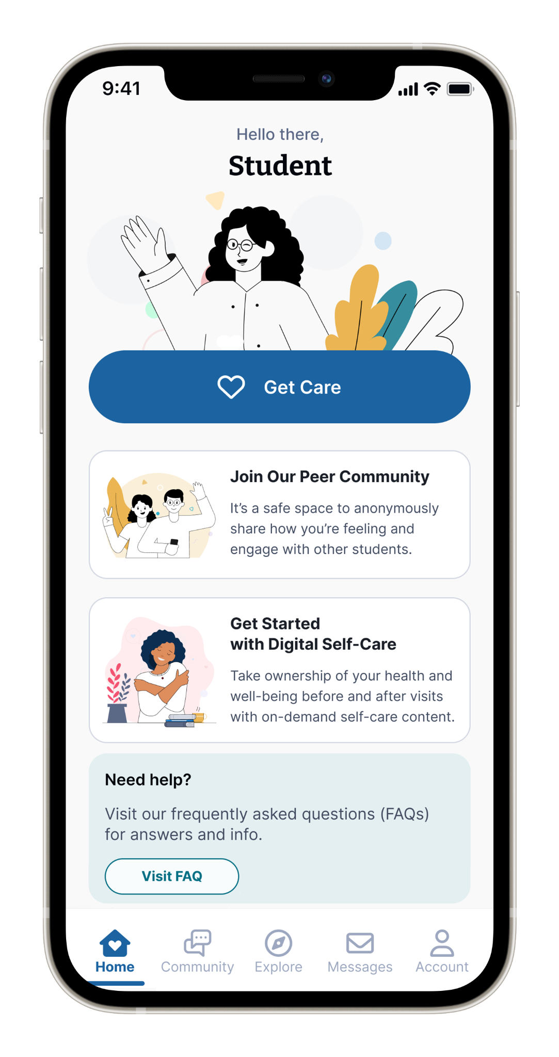







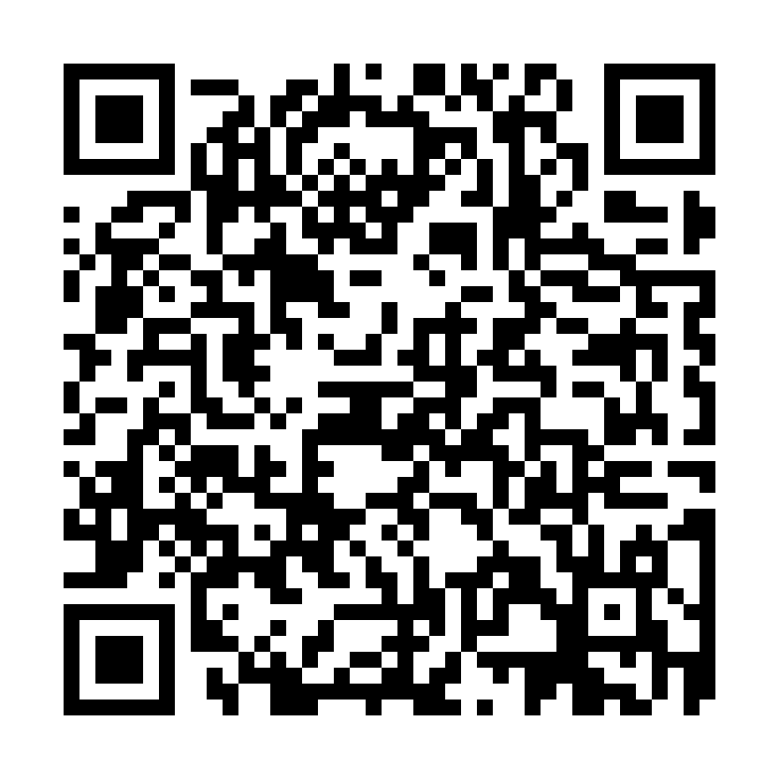





Your Virtual Health and Well-Being Resources
Available on the TimelyCare app or timelycare.com/sandiegocity
MedicalNow
TalkNow
Scheduled Medical
On-demand support for common health issues.
25/7, on-demand emotional support to talk about anything.
Choose your preferred day, time, and medical provider.
Self-Care Content
Basic Needs
Peer Community
Visit the “Explore” page for guided self-care content.
Access to free or reduced-cost community resources.
Share your experiences with a nationwide network of students.
QR CODE HERE
@timelycare
Scan the QR Code to access care.
@timely_care

